Slide 1
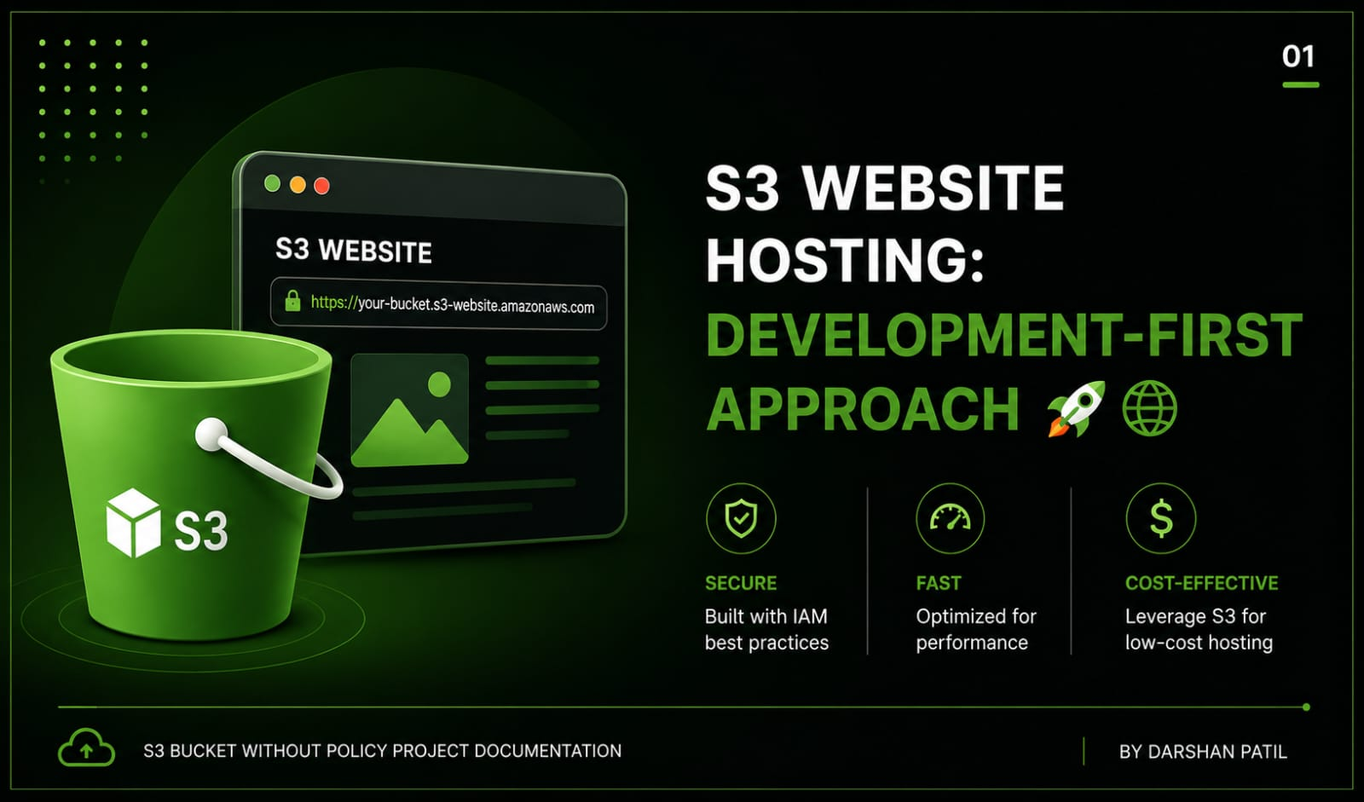

Slide 2
Introduction
Welcome to your comprehensive guide to AWS S3 static website hosting!🌐 While this tutorial focuses on a development-friendly approach without complex policies , It’s designed to give you a solid foundation in AWS S3 capabilities. Perfect the prototypes , personal projects, and learning environment.
Prerequisites
Before we begin, ensure you have:
🌐 An AWS account with administrative access
💻 Basic understanding of HTML/CSS
📁 Your website files ready for deployment
🌍 A modern web browser
☁️ Basic familiarity with cloud concepts
S3 BUCKET WITHOUT POLICY PROJECT DOCUMENTAITON

Slide 3
Important Security Notice
This guide prioritizes rapid development over production-grade security. For production deployments, you should implement:
🛑 Bucket policies for fine-grained access control
🌍 Cloud Front distribution for content delivery
🔒 SSL/TLS certificates via AWS Certificate Manager
🔐 WAF rules for additional security
🔑 Proper IAM roles and permissions
📖 Importance : This documentation is designed for educational and demonstration purposes only. While it provides a quick and easy way to host a website using Amazon S3, it does not include the security configurations required for production workloads. Always apply appropriate security measures and access controls before deploying applications in a live environment.🌎
S3 BUCKET WITHOUT POLICY PROJECT DOCUMENTAITON

Slide 4
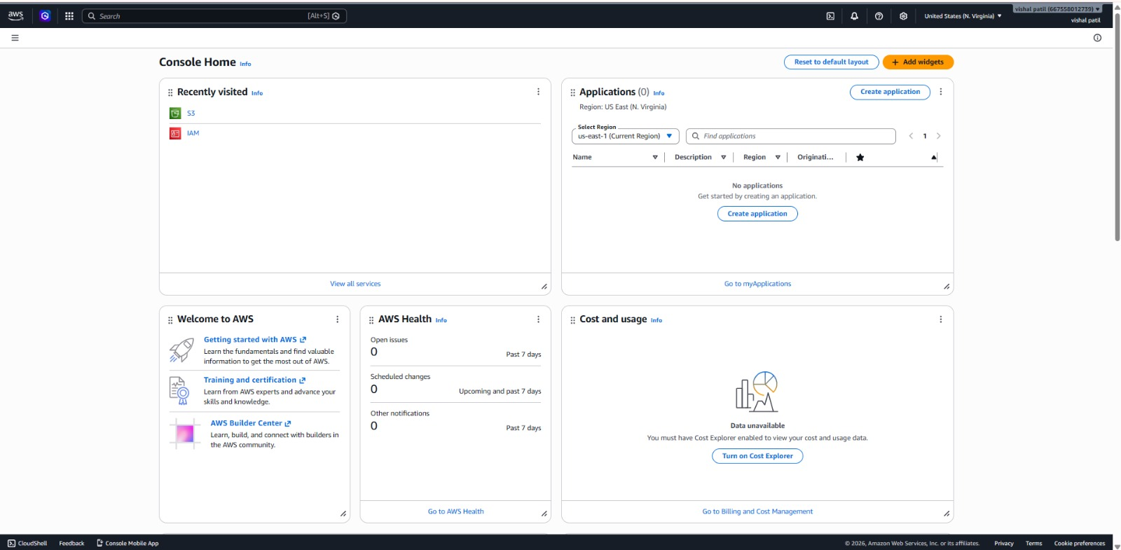
📌 Detailed implementation Guide
1.AWS Management Console Access :
Navigate to the management console
S3 BUCKET WITHOUT POLICY PROJECT DOCUMENTAITON

Slide 5
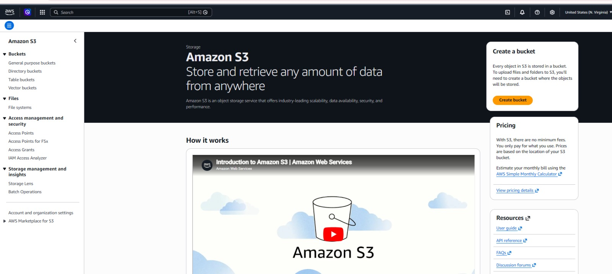
2. Location S3 Service :
Access S3 Through :
- AWS Console Search: Type “S3” OR “Simple Storage Service”.
S3 BUCKET WITHOUT POLICY PROJECT DOCUMENTAITON

Slide 6
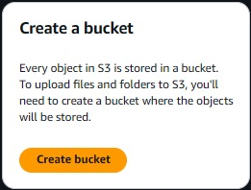
3. Bucket Creation And Configuration
Essential Settings:
Bucket Naming Conventions.
Must be globally unique across all AWS.
3-63 Characters Long.
Should be DNS – Compatible.
Can contain lowercase Letters , Numbers , Dots , And Hyphens.
Configuration Steps :
Click Create Bucket
S3 BUCKET WITHOUT POLICY PROJECT DOCUMENTAITON

Slide 7
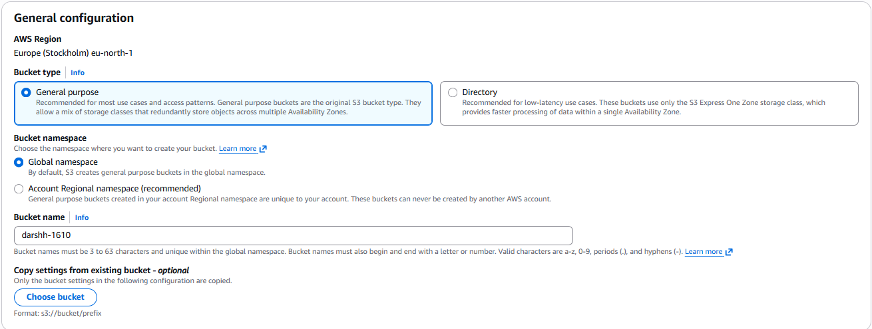
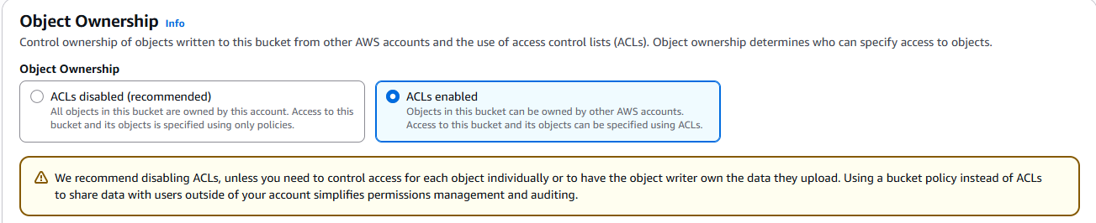
Enter bucket name following Convenations:
Configure Object Ownership:
- Select ALC’s enabled
S3 BUCKET WITHOUT POLICY PROJECT DOCUMENTAITON

Slide 8
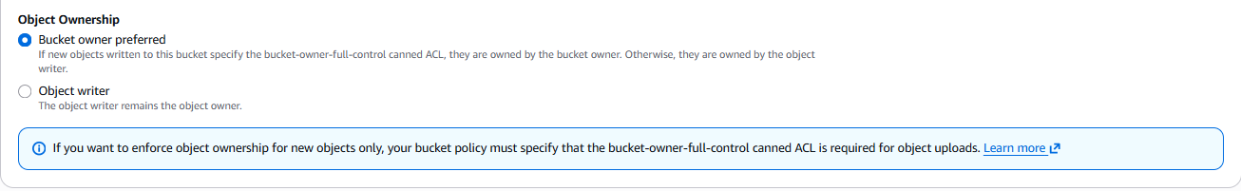
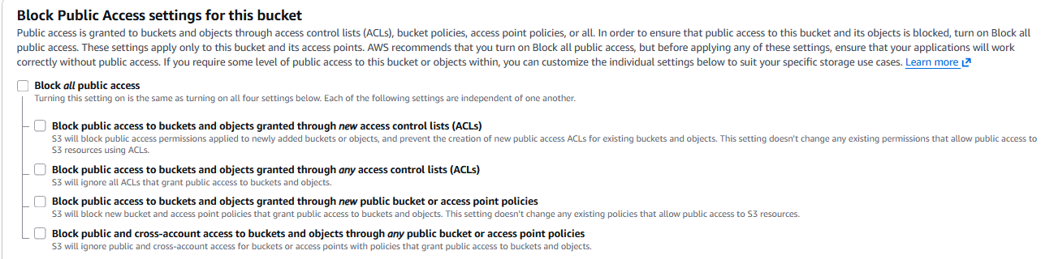
-Choose Bucket owner Preferred:
Public Access Setting :
- Uncheck all blocks Public Access Options
S3 BUCKET WITHOUT POLICY PROJECT DOCUMENTAITON

Slide 9
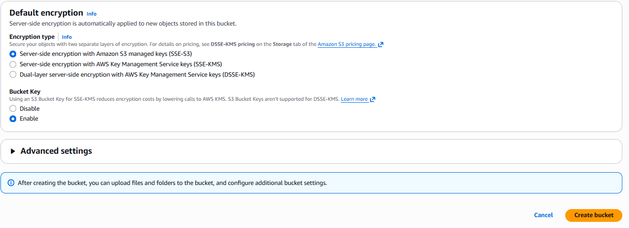
- Aknowledge The Public Access Warning
- Click the “Create Bucket” Button
S3 BUCKET WITHOUT POLICY PROJECT DOCUMENTAITON

Slide 10
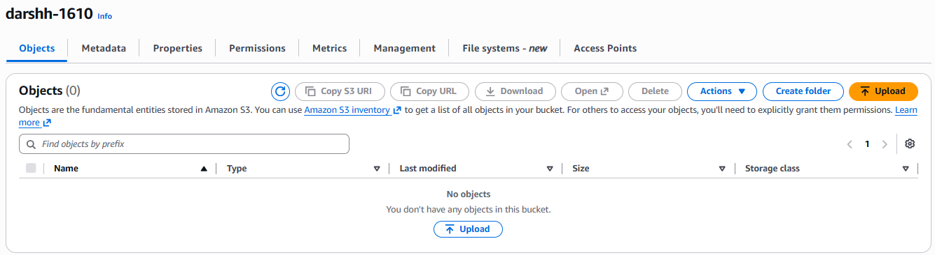
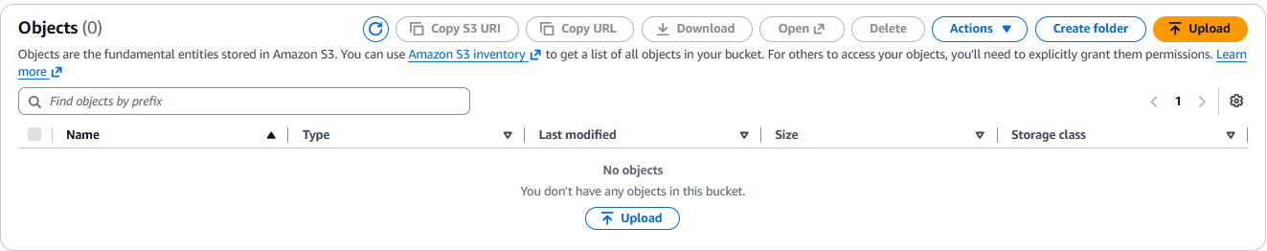
Upload Steps :
Navigate to bucket content
Click Upload
S3 BUCKET WITHOUT POLICY PROJECT DOCUMENTAITON

Slide 11
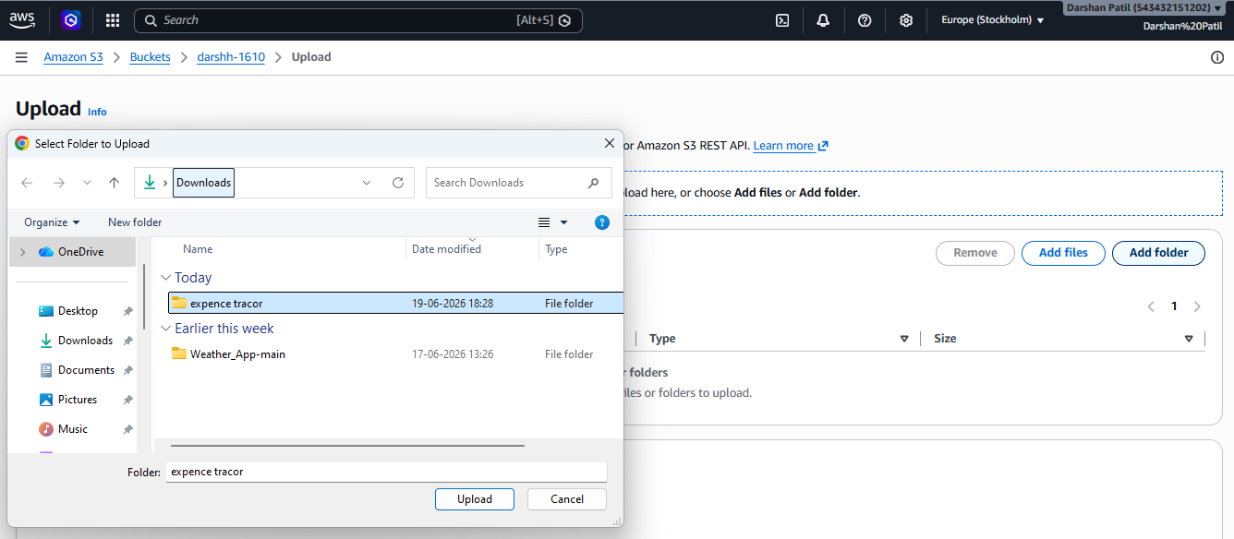
Configure upload settings
- Drag files or use file browser
S3 BUCKET WITHOUT POLICY PROJECT DOCUMENTAITON

Slide 12
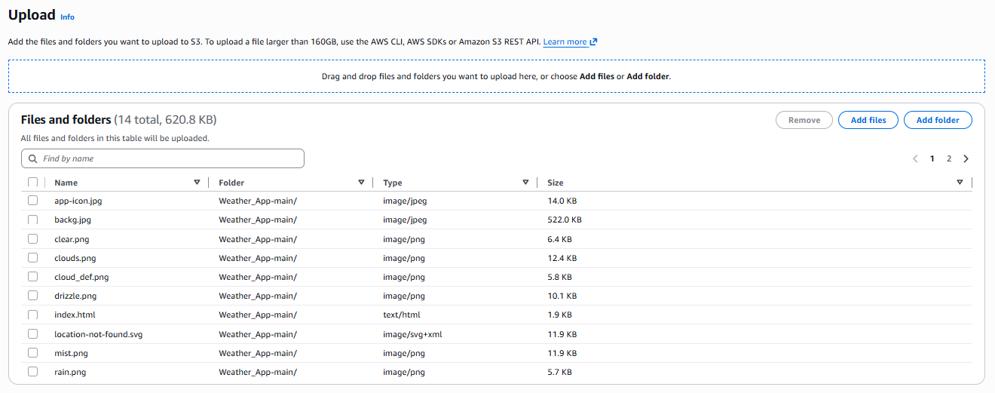
S3 BUCKET WITHOUT POLICY PROJECT DOCUMENTAITON

Slide 13
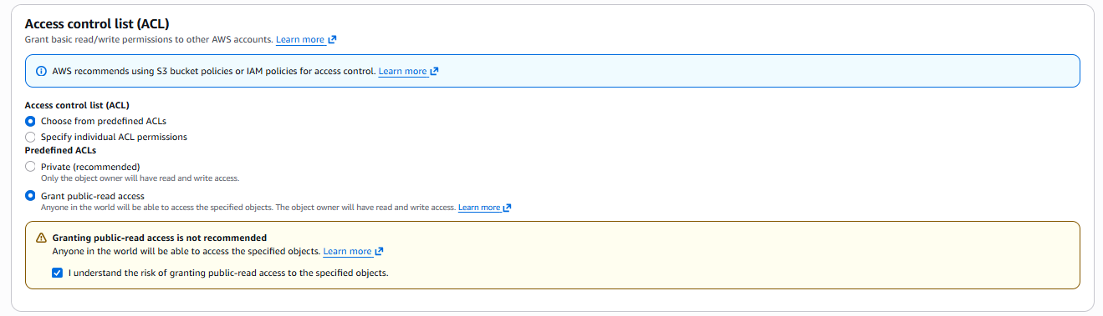
- Enable Public - read acess
- Aknowledge Public Access Setting
Uploading Process
S3 BUCKET WITHOUT POLICY PROJECT DOCUMENTAITON

Slide 14
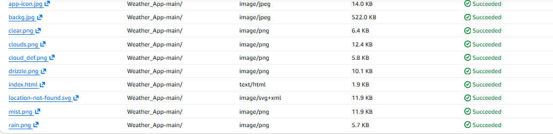
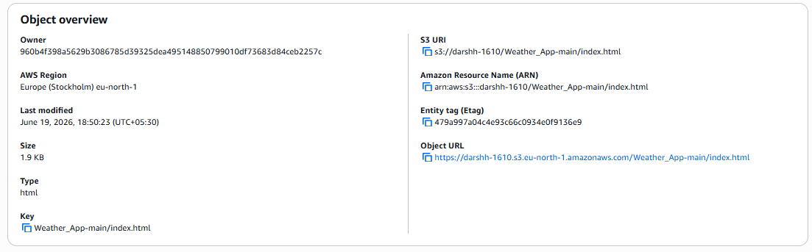
Click On index.html
S3 BUCKET WITHOUT POLICY PROJECT DOCUMENTAITON

Slide 15
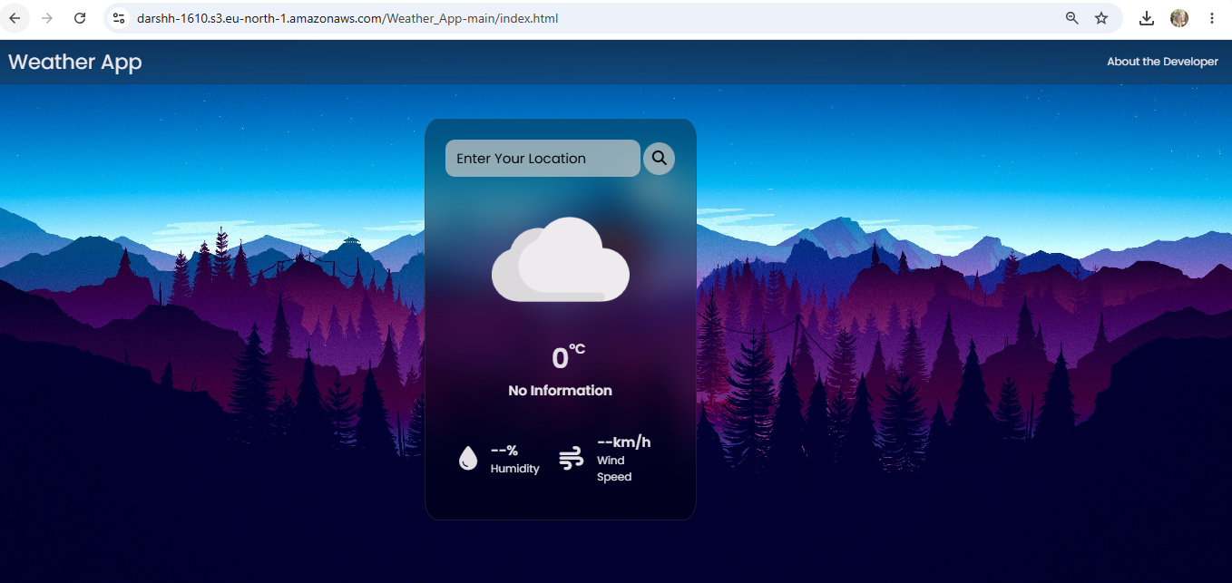
S3 Website Hosting Successfully
S3 BUCKET WITHOUT POLICY PROJECT DOCUMENTAITON

